Slide 1
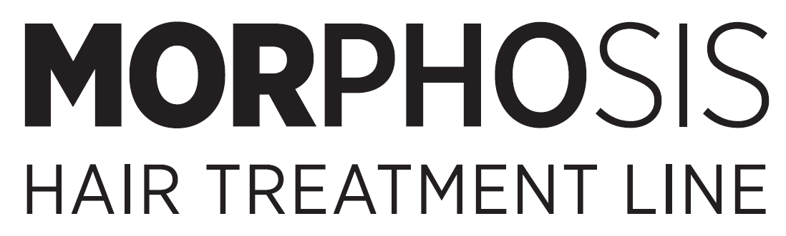
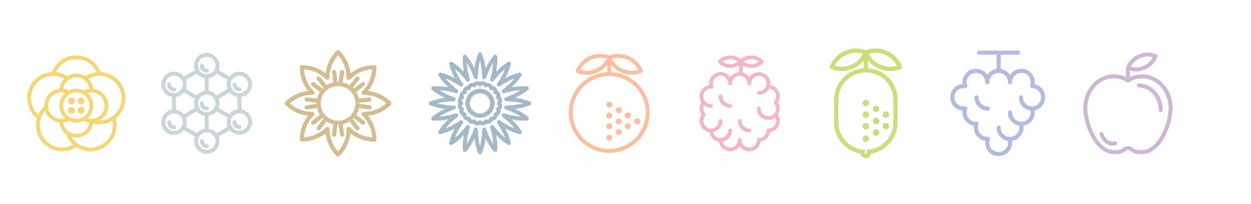


Slide 2


Slide 3
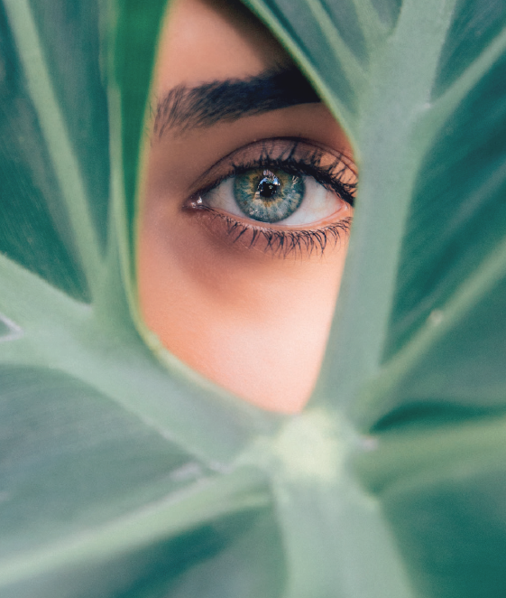
我們的靈感
現在，追求個人健康與愛護環境息息相關。
尋求整體美感同時也為環境留下美麗的足跡，framesi 一直走上可持續發展的道路。
而定義了新的Morphosis Hair Treatment永續媚力頭皮髮質系列，為您提供創新和可持續的產品。
完美滿足您所有頭皮、髮質的美麗需求的護理。
CONSCIUOUS BEAUTY
OUR INSPIRATION
I think, therefore I am. And, what’s more, I think, therefore I choose.
Now, aspiring to personal wellness goes hand in hand with care for the environment which, in turn, needs looking after.
The search for holistic beauty and knowing that all our gestures leave a footprint call us to walk down the sustainability path with determination.
In keeping with this consumer-inspiring ingredient, we have rethought and reformulated the Morphosis Hair Treatment line to offer you products that are increasingly more innovative and sustainable.
Perfect for answering all your Conscious Beauty needs.

Slide 4
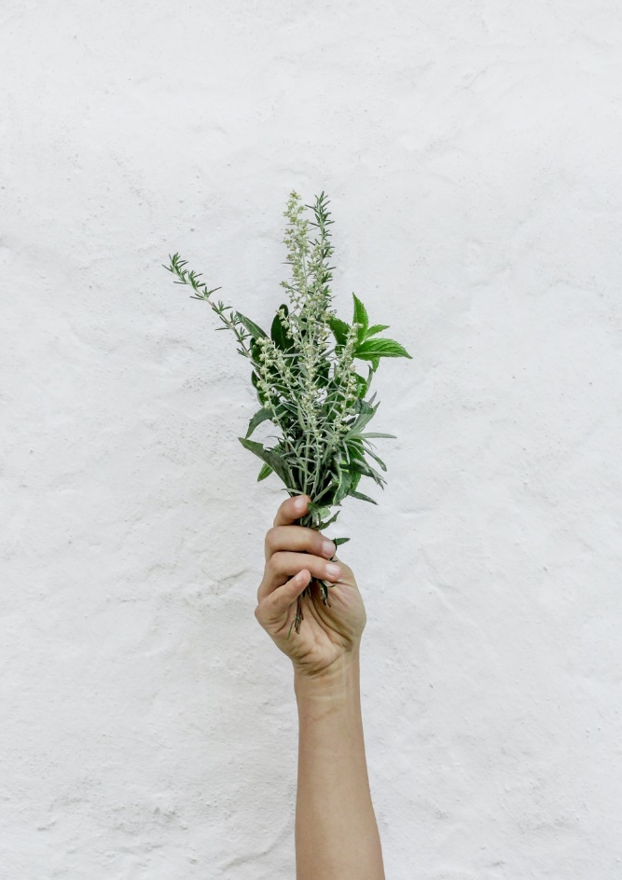

永續價值OUR VALUES
科學與自然相遇的結合
MORPHOSIS 給頭髮帶來最大的功能，減少對環境造成的影響。
· 就地取材
· PCR 認證再生塑膠
致力於發展塑膠回收產業的國際組織，讓廢棄的塑膠包裝能夠創造最大程度的價值
· FSC 認證紙
來自可持續管理，無森林砍伐的森林
Framesi 的出發點是與不斷變化的世界保持一致的趨勢，共同的價值觀。
運用自然的產品， 提供給沙龍的消費者「健康」的服務品質。

Slide 5
OUR VALUES
Still the symbol of science meeting nature, now MORPHOSIS gives hair
the greatest FUNCTIONAL and COSMETIC RESULTS WITH REDUCED
ENVIRONMENTAL IMPACT.
· Locally-sourced ingredients
· PCR certified recycled plastic
An international organization dedicated to the development of the plastic recycling industry, so that waste plastic packaging can create maximum value
· FSC certified paper
From sustainably managed, deforestation-free forests
Our choices for a Salon that is in tune with a changing world are not a trend,
but shared values.
Because we change. It’s natural.

Slide 6
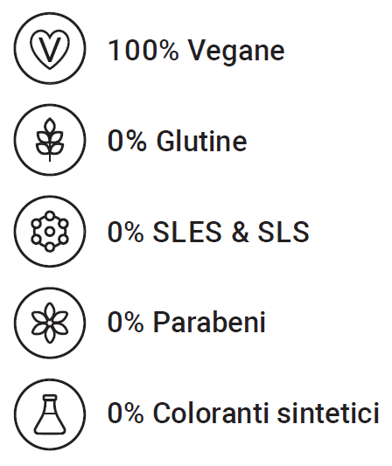
THE FORMULAS
100% 純植物 VEGAN
0%麩質 GLUTEN
0%十二烷基聚氧乙醚硫酸鈉&十二烷基硫酸鈉
SLES & SLS
0% 防腐劑 PARABENS
0% 合成色 SYNTHETIC COLORS
自然界的餽贈Natural
Morphosis 護理系列產品的功能和美觀性
高達 98% 的天然成分配製而成，其中大部分來自地中海地區天然成分。
Technologically advanced to provide the best results in terms
of effectiveness and aesthetics, the Morphosis Hair Treatment lines are formulated with up to 98% natural ingredients, most of them
from the Mediterranean regions.
Technologically advanced to provide the best results in terms
of effectiveness and aesthetics, the Morphosis Hair Treatment lines are formulated with up to 98% natural ingredients, most of them
from the Mediterranean regions.

Slide 8
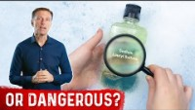

Slide 9

13 surfactants of which 12 plant-based ones
17 natural oils with 3 essential ones
5 protein extracts + 3 amino acids
7 vitamins
17 multifunctional extracts, with 5 fermented ones
65 key ingredients
多種天然成分 A FEW FIGURES
13 surfactants of which 12 plant-based ones
17 natural oils with 3 essential ones
5 protein extracts + 3 amino acids
7 vitamins
17 multifunctional extracts, with 5 fermented ones
65 key ingredients
13 種表面活性劑，其中12種植物性表面活性劑
17 種天然精油，含 3 種精油
5 種蛋白質萃取物 + 3 種氨基酸
7 種維生素
17 種多功能萃取物，含 5 種發酵萃取物
65 種關鍵成分

Slide 10
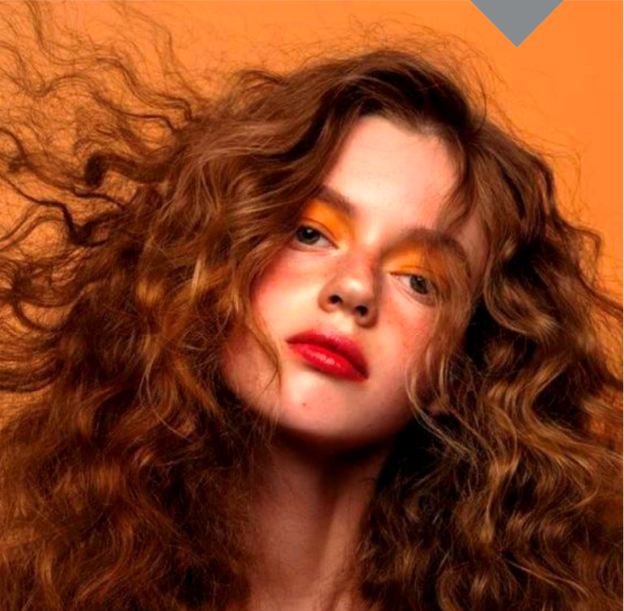
香氛 THE FRAGRANCES
疫情期間焦慮與煩躁隨之急速增加，內心小宇宙不斷爆發、充满呐喊。
後疫情時代生活逐步恢復正常，但壓力、緊繃仍殘存於記憶中，自我療癒、解除壓力、提升免疫力就更為被重視。
芳香療法 Aroma therapy
人的情緒有75%是由嗅覺產生，對照片的記憶在三個月後剩下50%，但對一年前的氣味記憶淮確度卻高達65%。香氛精油經由呼吸道或肌膚吸收，帶來舒缓情緒、放鬆心靈療癒效果，同時保健身體的一種自然療法。

Slide 11
THE FRAGRANCES
During the epidemic, anxiety and irritability increased rapidly, and the small universe in my heart continued to explode and full of shouts.
In the post-epidemic era, life is gradually returning to normal, but the stress and tension are still in the memory. Self-healing, stress relief, and immunity enhancement are more important.
Aroma therapy
75% of people's emotions are generated by the sense of smell, and the memory of the photo remains 50% after three months, but the accuracy of the memory of the smell a year ago is as high as 65%.
Fragrance essential oils are absorbed through the respiratory tract or skin, bringing soothing emotions, relaxing the healing effect of the mind, and at the same time, a natural therapy for the body.

Slide 12
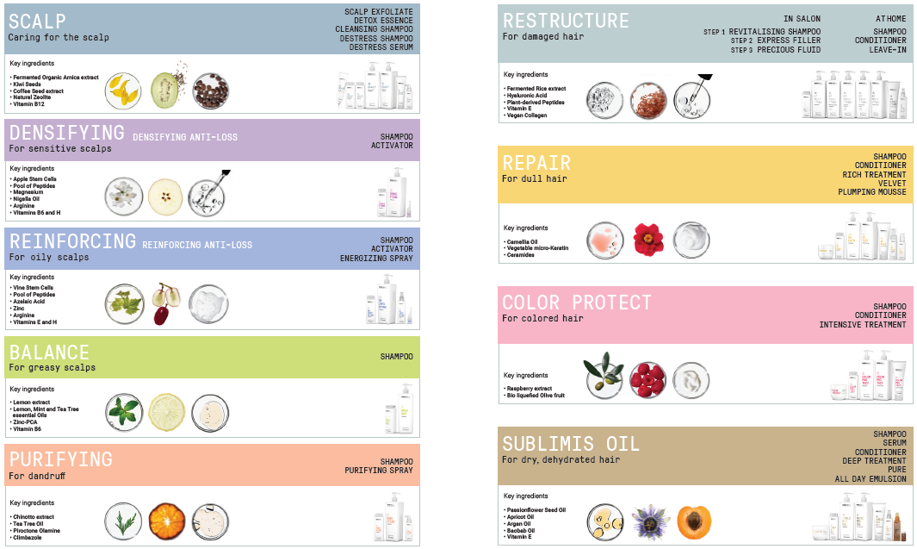

Slide 13
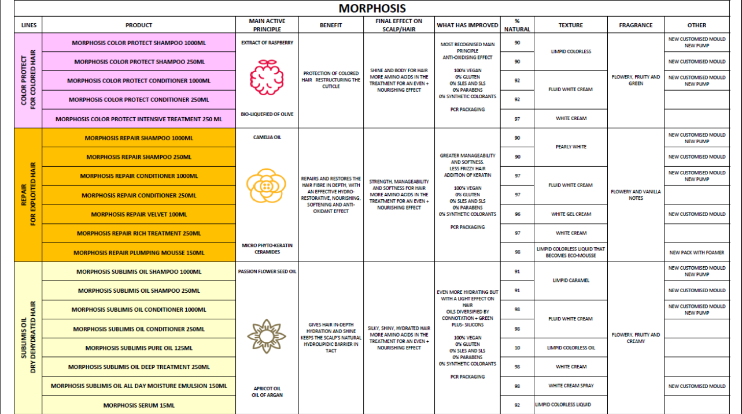

Slide 14
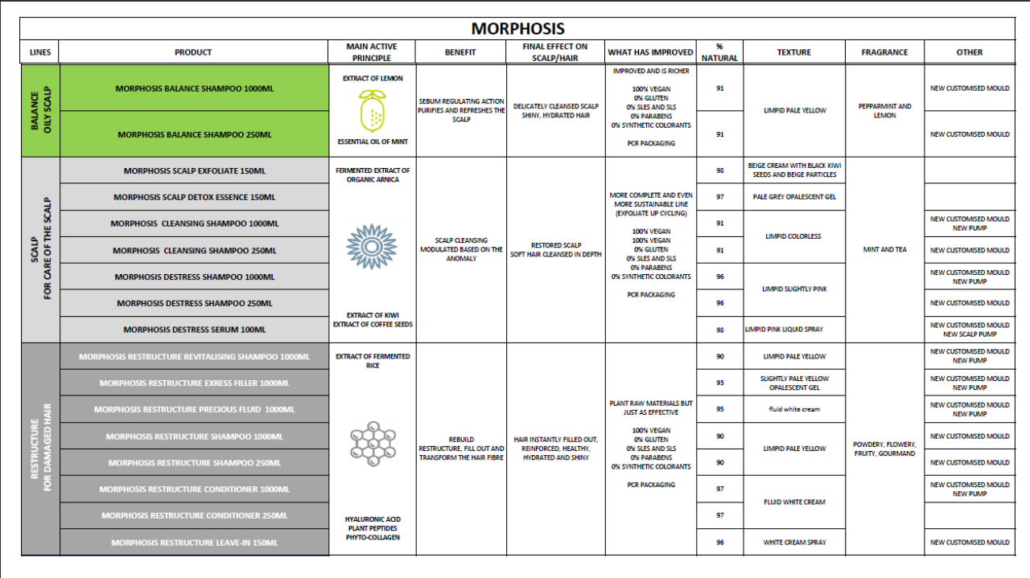

Slide 15
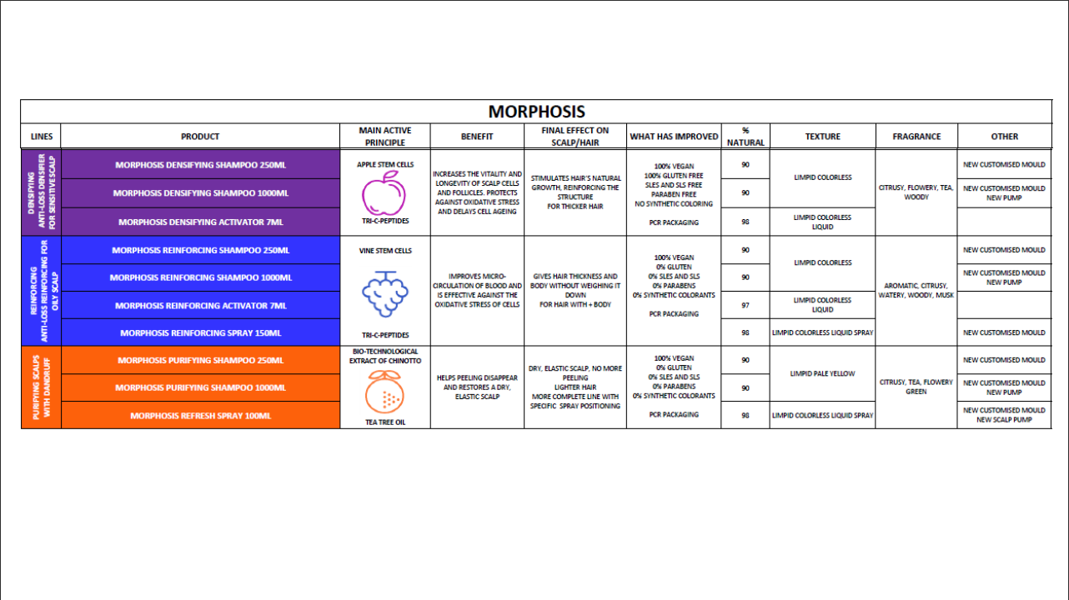

Slide 16
人口老齡化+亞健康問題推動=健康消費需求
Population aging + improvement of sub-health problems = healthy consumption demand.

Slide 17
SPA一字源於拉丁文
Solus Por Aqua Solus=健康 Por=經由⋯ Aqua=水
其實，就是經由水來產生健康。
The word SPA comes from Latin
Solus Por Aqua Solus = Health / Por=via… / Aqua=Water
In fact health is generated through water.

Slide 18
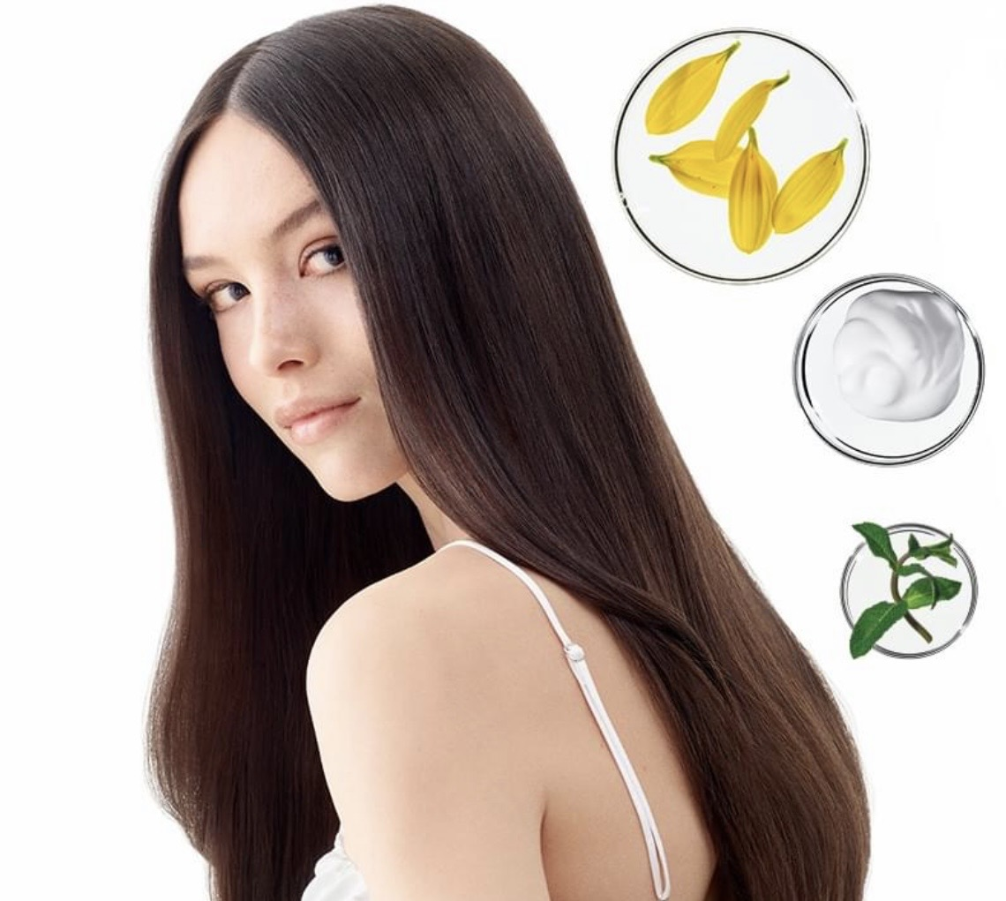
頭部完整呈現你的身心狀況
頭部與臉部聚集了視覺、聽覺、嗅覺味覺
觸覺的感覺器官
從頭部與臉部就可以看出來身體健康狀況。
頭與臉部的特定部位，是與身體的12個主要內臟器官有關聯，了解對應的內臟出現的問題。

Slide 19
The head fully presents your physical and mental condition.
The head and face gather the sensory organs of sight, hearing, smell, taste and touch.
The health status of the body can be seen from the head and face.
The specific parts of the head and face are related to the 12 main internal organs of the body, so as to understand the problems of the corresponding internal organs.

Slide 20
 | 頭髮異常現象 | 身體呈現狀況
1 | 20歲左右便出現M字形額頭 | 可能與卵巢疾病或癌變有關。
2 | 頭皮出油量多，頭頂部嚴重脫髮 | 容易口臭，胃腸消化問題多。
3 | 頭頂髮質變細且稀疏 | 日常呼吸困難，肺或呼吸器官有毛病。
4 | 毛髮細，黏於頭皮 | 毛根只長單根髮，多是風濕病症候群。
5 | 耳部上方脫髮明顯或稀少 | 兼有耳鳴，手腳關節會痛，多為關節神經痛。
6 | 脖子上方髮際線的頭髮成波浪狀 | 兼有下腹痠痛或疼痛，常是女性生理機能毛病。
7 | 額頭的兩側或太陽穴位頭髮異常 | 眼常疲勞，視物不清，視神經有毛病。
8 | 耳邊的頭髮稀疏特別明顯 | 兼有賬口困難疼痛，可能有牙齒炎症或蛀牙。
9 | 前額中央的頭髮異常可見 | 常有鼻塞、記憶力減退，鼻部有毛病。
10 | 後腦杓白髮變多，異常脫髮或髮變細 | 兼有聲音嘶啞 ，分泌物多，為咽喉炎症。
11 | 頭部前後的頭髮都發生明顯變化 | 容易內急，排便有血，不是便祕，就是痔瘡

Slide 21
 | Hair Abnormalities | Physical Reaction
1 | M-shaped forehead appears around the age of 20. | The ovaries are prone to disease or cancer.
2 | Excessive oily scalp and severe hair loss on the top of the head. | It is easy to have bad breath and many gastrointestinal digestive problems.
3 | Thinning and thinning hair on the top of the head. | Difficulty breathing in daily life, problems with the lungs or respiratory organs.
4 | fine hair, sticky to scalp. | The hair root only grows a single hair, which is mostly rheumatic syndrome.
5 | Significant or sparse hair loss above the ears. | Both tinnitus, hands and feet joint pain, mostly joint neuralgia.
6 | The hairline above the neck becomes wavy. | With lower abdominal pain or pain, it is often a female physiological function problem.
7 | abnormal hair on the sides of the forehead or on the temples. | Eye fatigue, blurred vision, and optic nerve problems.
8 | Especially thinning hair around the ears. | Difficulty opening the mouth with pain and possible tooth inflammation or tooth decay.
9 | Unusual visible hair in the center of the forehead. | Nasal congestion, memory loss, and nose problems are common.
10 | Increased white hair on the back of the head, abnormal hair loss or thinning. | The voice is easy to be hoarse and the secretions are excessive, leading to throat inflammation.
11 | Significant changes in the hair on the front and back of the head. | Easy internal urgency, bloody defecation, either constipation or hemorrhoids.

Slide 22
 | 頭髮異常現象 | 身體呈現狀況
1 | 直髮變成了波浪形捲髮或萎縮毛 | 焦躁、不安、失眠、自律神經失常。
2 | 頭頂髮旋周圍3公分頭皮常微紅 | 有時突然臉色發青，心臟有病變。
3 | 頭頂髮旋右前方異常脫髮，長白髮或頭髮變細 | 常有噁心，右上腹疼痛，膽囊有毛病。
4 | 頭髮出油量多，每天洗髮依然頭皮黏塌嚴重 | 心情煩躁，甲狀腺機能毛病。
5 | 頭皮出油量過多，常有褐色皮屑，頭髮油膩 | 頭髮變細，髮際線增高，雄激素長期偏高（男）。
6 | 女性髮質突然變粗，唇毛變粗變黑 | 手腳毛增加，乳暈長粗毛，雄激素偏高已久。
7 | 髮質變乾、變細、易斷、毛燥 | 容易神經質，長期失眠，雌激素偏低。
8 | 頭髮出現節狀、粗糙、易斷、變色 | 常有抽筋現象，突然站立容易暈眩，血液循環較不良。
9 | 頭髮突然由白變黑，膚質變細 | 手腳毛變細、變少，為雌激素偏高，荷爾蒙失調。
10 | 突然大量脫髮 | 精神過度刺激，產後或病後營養失調、藥物、癌症等。
11 | 頭髮脫落量突然變多，毛躁，不易梳理 | 營養不均衡，產後、病後，不正確減重，代謝不平衡。

Slide 23
 | Hair Abnormalities | Physical Reaction
1 | Straight hair that becomes wavy or atrophied. | Anxiety, restlessness, insomnia, autonomic nervous disorder.
2 | The scalp is often reddish around 3 cm around the crown of hair. | Sometimes his face suddenly turns blue and his heart has pathological changes.
3 | Abnormal hair loss, white hair or hair thinning in the right front of the head. | Often nausea, right upper quadrant pain, gallbladder problems.
4 | There is a lot of oil in the hair, and the scalp is still sticky after shampooing every day. | Irritable mood, thyroid function problems.
5 | Excessive oily scalp, often with brown flakes, greasy hair. | The hair becomes thinner, the hairline becomes higher, and the androgen is high for a long time (male).
6 | Female hair suddenly thickens, lip hair thickens and turns black. | The hair on the hands and feet has increased, the areola has long hairs, and the androgen has been high for a long time.
7 | Dry, thin, brittle, frizzy hair. | Easily nervous, long-term insomnia, low estrogen.
8 | Knotty, rough, brittle, discolored hair. | There are often cramps, dizziness when standing suddenly, and poor blood circulation.
9 | Hair suddenly turns from white to black, skin becomes thinner. | Thinner and less hair on hands and feet is due to high estrogen and hormonal imbalance.
10 | udden heavy hair loss. | Mental overstimulation, nutritional disorders after childbirth or illness, drugs, cancer, etc.
11 | Sudden increase in hair loss, frizzy, difficult to comb. | Imbalanced nutrition, postpartum, post-illness, incorrect weight loss, and metabolic imbalance.

Slide 24
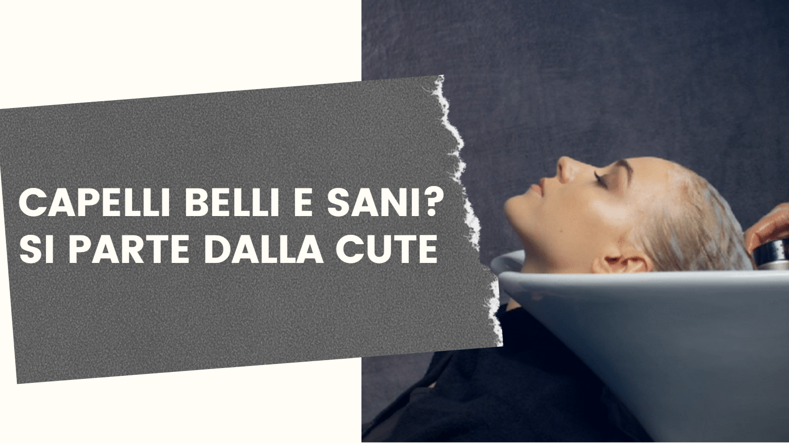
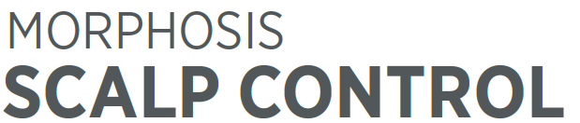
更完整的頭皮髮質系列
優質沙龍服務

Slide 25
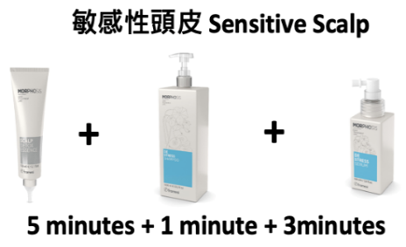
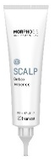
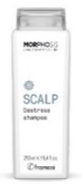
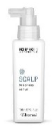
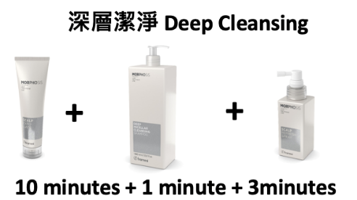
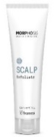


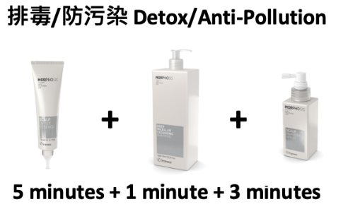
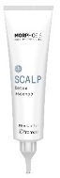
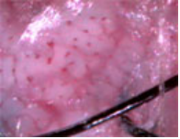
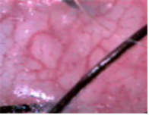
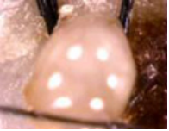
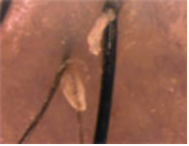
症狀 | 圖示 | 造成因素
微血管microvascular/ Capillaries |  | 易與癬菌混淆。 Easy to confuse with ringworm.
癬菌 Trichophyton |  | 表面的黴菌與微生物因冷發性感染造成搔癢。 Molds and microorganisms on the surface cause itching due to cold infections
皮脂角化Sebaceous Keratosis |  | 因皮脂異常阻塞在頭皮毛囊內和毛根鞘而影響毛細孔表皮生長。 Abnormal sebum obstruction in the hair follicles and root sheaths of the scalp affects the growth of the pores and epidermis.
膿胞（黴菌）Pyocytosis (mold) |  | 多種的內外因素造成細菌感染，有紅、熱、腫痛的現象以及綠膿 、黑膿、紅膿、黃膿、白膿、水膿各種類型的膿胞。 A variety of internal and external factors cause bacterial infections, such as redness, heat, swelling and pain, and various types of pus, black pus, red pus, yellow pus, white pus, and water pus.

Slide 26
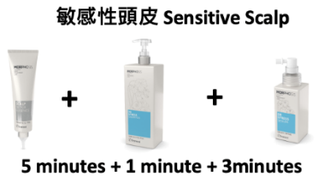
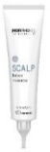
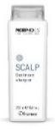
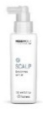
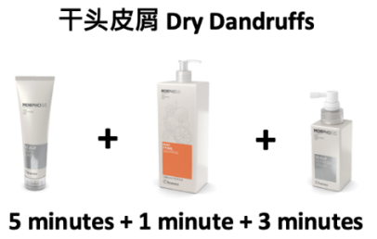

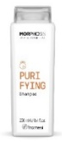
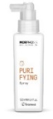
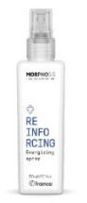
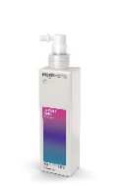
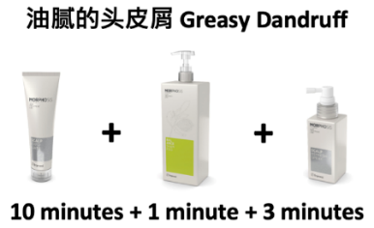

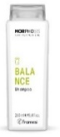

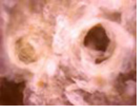
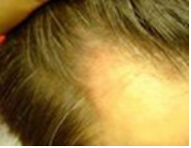
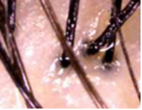
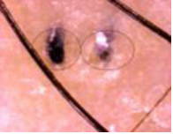
頭皮紅腫 Swollen and scalp redness |  | 藥物、添加物過敏性、表皮細胞組織異常增生、 脂層炎性、代謝機能異常、維生素缺乏。 Drug, additive allergy, abnormal hyperplasia of epidermal cell tissue, lipid layer inflammation, abnormal metabolic function, vitamin deficiency.
頭皮屑dandruff |  | 成熟的皮屑是無核的粉末狀，但如有乾癬、脂漏性黴菌、皮屑芽 孢菌、 毛髮癬菌、小芽孢癬菌、不當的化學物時， 角質層會以片狀剝落成為頭皮屑。 Mature dander is a seedless powder, but if there are psoriasis, seborrheic mold, dander buds, trichophyton, microsporum tinea, or inappropriate chemicals, the stratum corneum will peel off in flakes. Dandruff
斷髮 Hair Breakage |  | 毛幹的生命仍持續時，因受到身體機能的內因素及人力不當操作 的外因素受到破壞而斷裂。 While the life of the hair shaft is still going on, it breaks due to damage caused by internal factors of body function and external factors of improper operation of manpower.
油性頭皮 Greasy Scalp |  | 攝取大量動物性脂肪、長期壓力累積、連續熬夜 會造成皮脂腺油脂的分泌過剩。 Ingestion of large amounts of animal fat, long-term stress accumulation, and continuous staying up all night will cause excessive secretion of sebaceous gland oil

Slide 27
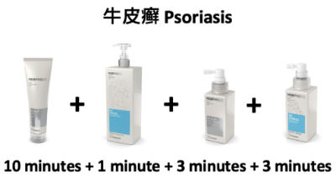




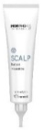
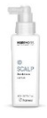
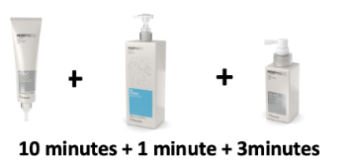
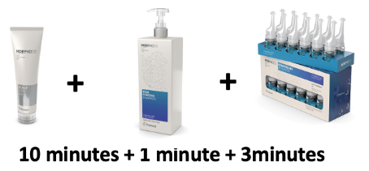
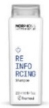
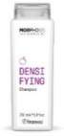
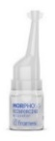
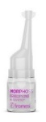








頭皮乾癬 Psoriasis |  | 壓力大、煩惱多、睡眠不足、情緒惡劣、顯性遺傳、 藥物、過量 煙酒、維生素缺乏。 Stress, troubles, lack of sleep, bad mood, dominant inheritance, drugs, excessive tobacco and alcohol, and vitamin deficiency.
溼疹 eczema |  | 過敏遺傳基因、生活環境因素、蟲、微生物感染、 化學物及絲織品的刺激。 There are allergic genetics, living environment factors, insects, microbial infections, chemicals and silk fabrics
脫髮 HairLoss |  | 未達生命終點前，因某種的內外因素造成髮根萎縮稱為掉髮。 內因 － 有遺傳病、內分泌缺損、營養缺乏、癌症治療、維生素不足、 礦物質(鐵、銅、鋅)的缺乏、懷孕、生產、感冒、 失血、藥物、甲狀腺機能、壓力、重病。 外因 － 放射線、偏食、節食、紫外線過度照射、化學感染。 Before reaching the end of life, hair root shrinkage caused by some internal and external factors is called alopecia. Internal causes include genetic diseases, endocrine defects, nutritional deficiencies, cancer treatment, vitamin deficiency, mineral (iron, copper, zinc) deficiency, pregnancy, birth, colds, blood loss, medications, thyroid function, stress, and serious illness. External causes-Radiation, partial eclipse, dieting, excessive UV exposure, and chemical infections.
癬菌Trichophyton |  | 外在環境衛生或身體的機能功能下降，易感染癬菌。癬菌的病原 有小芽孢癬菌、毛髮癬菌、皮癬菌等類種。 External sanitation or decline in body functions make it susceptible to infection with ringworm. The pathogens of ringworm include Bacillus microsporum, Trichophyton, and Dermatophytes.

Slide 28










脂漏頭皮 Seborrheic Dermatatis |  | 體內血清及皮膚中的膽固醇對卵磷脂的比例較低， 有先天遺傳基 因、後天飲食不當、胃腸道疾病、新陳代謝失常、 內分泌失調、 維生素缺乏、神經精神等因素。 The ratio of cholesterol to lecithin in the body's serum and skin is low, due to congenital genetic factors, acquired improper diet, gastrointestinal diseases, metabolic disorders, endocrine disorders, vitamin deficiency, neuropsychiatric and other factors.
真菌 Fungus |  | 當空氣中或水中的微生物附著在潮濕的頭髮上， 因綁頭髮或盤髮時與頭皮的溫度結合而生成真菌。 When microbes in the air or water adhere to damp hair, they combine with the temperature of the scalp when the hair is tied or curled to form fungi.
角化症 Keratinization |  | 因蛋白質、皮脂異常而影響毛細孔表皮生長， 使毛細孔角化過度形成栓塞。 Abnormal protein and sebum affect the growth of the epidermal pores, causing excessive keratinization of the pores to form embolism.
微生物 microorganism |  | 空氣中和水中都有著細菌， 會附著在我們的皮膚與毛髮上無法去除而成形。 TherThere are bacteria in the air and water, which will adhere to our skin and hair and cannot be removed and formed.

Slide 29




















長不出的頭髮 InnerGrowth Hair |  | 毛細孔因有病理性、物理性、化學性、職業性『傷害』， 而造成阻塞或密合使毛髮無法長出。 Due to pathological, physical, chemical, and occupational "injuries", the pores are blocked or tightly closed to prevent hair growth.
癬菌咬髮 Ringworm bites |  | 當小芽孢癬菌、毛髮癬菌、皮癬菌的孢子菌入侵髮幹， 破壞表皮 層的扁平細胞、皮質層的長型細胞、 髓質層的油粒蛋白細胞而使 髮幹斷裂。 When the spores of Bacillus microsporum, Trichophyton, and dermatophytes invade the hair shaft, they destroy the flat cells in the epidermis, the long cells in the cortex, and the oleogranin cells in the medulla layer and break the hair shaft.
過敏性頭皮hypersensitivity scalp |  | 因皮膚代謝異常、內分泌失調、營養不均衡、精神壓力、 全身機能性下降而表現。 It is manifested by abnormal skin metabolism, endocrine disorders, unbalanced nutrition, mental stress, and decreased systemic function.
乾性頭皮 Dry scalp |  | 當角質層的細胞構造受損時，保濕及防禦功能會降低， 水分被排出體外，導致表皮細胞活動力變差，上表皮就變成乾燥的。 When the cell structure of the stratum corneum is damaged, the moisturizing and defense functions will be reduced, and water will be excreted out of the body, resulting in poorer epidermal cell activity, and the upper epidermis will become dry.

Slide 30

Detox Essence
Balance
Treatment
before
after
the first week
the second week
The third week
the fourth week

Slide 31

Exfoliate
Purifying
Treatment
before
after
the first week
the second week
The third week
the fourth week

Slide 32

為何要按摩頭部呢？
頭部按摩具有四大功能
1.促進血液循環 2.達到舒缓全身的效果
3.預防頭髮脫落 4.提拉皮膚效果
Why do you want to massage the head?
Head massage has four effects
1. Promote blood circulation
2. To achieve the effect of soothing the whole body
3. Prevent hair loss
4. Lifting effect on the skin

Slide 33

頭部按摩的秘訣與重點
1.無名指 力道較弱的指頭指腹來輕輕按壓
2.中指或無名指 刺激穴位
3.握拳 利用手指關節按摩
4.指尖皮膚 變色時，代表過度用力
Tips and key points of head massage
1.The strength of the ring finger is weak. The pulp of the finger is suitable for light pressing.
2.The middle finger or ring finger. The pulp of the finger is suitable for stimulating acupuncture points.
3.Make a fist and use your finger joints to massage.
4.When the fingertip skin changes color, it means excessive force.

Slide 34

1.
梳髮 - 順著1、2、3區梳髮，每一區梳理 3次
Comb hair - Comb hair along zones 1, 2 and 3
each zone 3 times

Slide 35

2.
將頭部分四大區，每一區域間隔1cm至1.5cm
均勻塗抹Exfoliate或 Scap Detox Essence
再按摩肩頸
Divide the head into four regions, each region is separated by 1cm to 1.5cm，Apply Exfoliate or Scap Detox Essence evenly

Slide 36

3.
均勻塗抹按摩油在肩頸部位
Apply massage oil evenly on the neck and shoulders

Slide 37

4.
使用大拇指在大椎穴兩側，劃圈三下再滑至肩頸穴
這個動作重複3次
Use your thumb on both sides of the Dazhui point, draw a circle three times and then slide to the shoulder and neck point, repeat this action 3 times

Slide 38

5.
每一區使用拳頭關節，依序由上往下滑動 3次
Use fist joints in each area, slide from top to bottom 3 times in sequence

Slide 39

6.
每區雙手交叉擠壓3次
Cross hands and squeeze 3 times in each area

Slide 40

7.
雙手服貼劃圈至頭頂區定點，手掌服貼，由外而內
由下往上定點劃圈 15下
Draw circles with both hands to the fixed point on the top of the head, stick the palms to the fixed point, draw circles from outside to inside, from bottom to top 15 times

Slide 41

8.
將頭部分四大區，每一區域使用按摩梳以z字型按摩頭皮
Divide the head into four areas, and use a massage comb to massage the scalp in a z-shape for each area

Slide 42

9.
將頭部分五大區，每一區域使用按摩梳，由髮際線開始間隔2cm左右定點劃圈按摩頭皮
按摩完畢即可清洗頭髮
Divide the head into five areas, use a massage comb for each area, start from the hairline, massage the scalp at fixed points at intervals of about 2cm
Shampoo hair after massage

Slide 43

頭皮精華導入梳
MORPHOSIS SCALP APPLICATOR COMB
將 密植舒敏華液 或 密植平衡華液 倒置 頭皮精華導入梳
順著1、2、3區梳髮，將精華液導入頭皮，每一區梳理 3次
讓頭皮吸收精華液
Will densifying activator or reinforcing activatorINVERTED MORPHOSIS SCALP APPLICATOR COMBComb hair along areas 1, 2, and 3, introduce the essence into the scalp, and comb each area 3 timesLet the scalp absorb the essence

Slide 44


